Slide 1
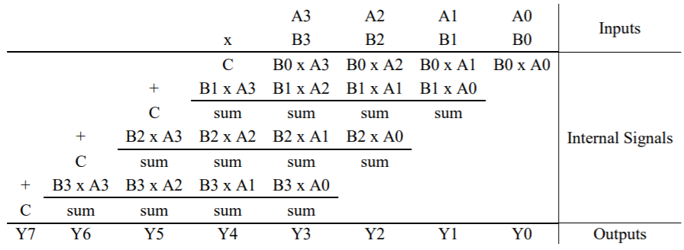
Array multiplication
Let us consider the multiplicand to be M = (A₃, A₂, A₁, A₀) and the multiplier to be Q = (B₃, B₂, B₁, B₀)

Slide 2
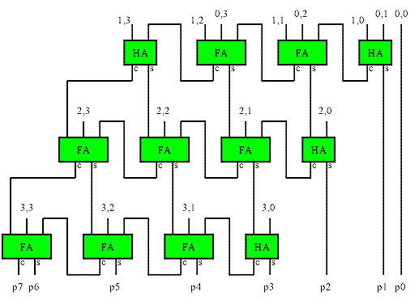
Hardware configuration of 4*4 Array multiplier
For m-bit*n-bit multiplier we need m*n AND gates, n Half adders, and (m-2)*n Full adders

Slide 3
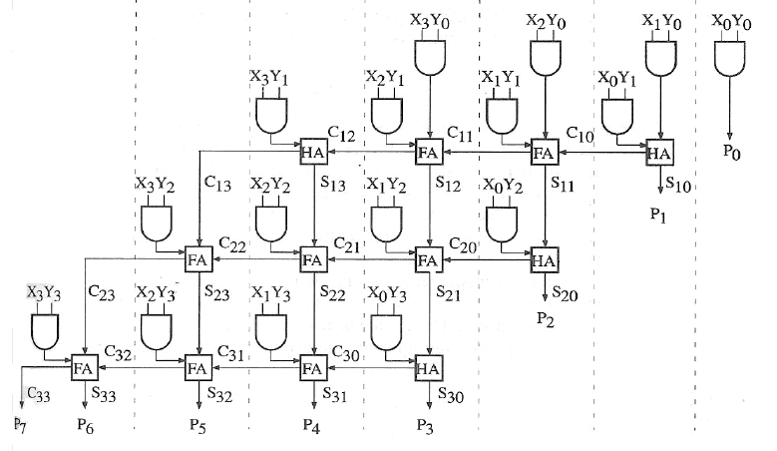
Hardware configuration of 4*4 Array multiplier
For m-bit*n-bit multiplier we need m*n AND gates, n Half adders, and (m-2)*n Full adders

Slide 4
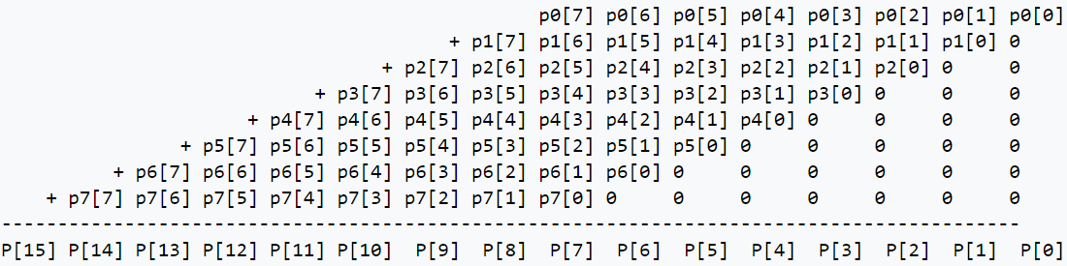
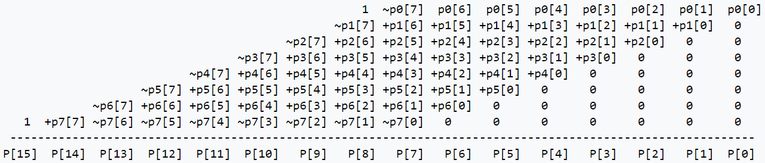
Signed multiplication using array multiplier

